Slide 1

EOSE09 Lab 1
Lab paper in detail (5 mins)
Getting set up (20 mins)
Packages & data (20 mins)
Summary statistics (5 mins)
Basic Maps (25 mins)
Practice (15 mins)
Notes:
Hello everyone and welcome to the lab today.
Can I ask you to pass around the sweets and take one of each colour
There is a lot to get through today, so I want to assure you that you don’t need to worry about keeping up – everything that I cover will be on the course website (demo)

Slide 2

Don’t worry about keeping up:
Notes:
https://j-jayes.github.io/EOSE09-site/

Slide 3

Lab paper
Presentation
To get feedback on your work
March 14th
Paper
Final hand in for both report and Stata code
March 21st
Notes:
I want this paper to be useful in that you learn something.
I want to make it easy both to pass and to do well.

Slide 4

Lab paper components
Title
Introduction
Literature review / theoretical background
Data and methods
Analysis and discussion
Conclusion
Notes:
This might seem boring – but I want to talk you through an example paper in order to make it clear what is required.

Slide 5
Lab paper title
• Clearly state the topic, region, and period. • Signal the focus (e.g., convergence, structural change).
Bridging the Gap? An Analysis of the North–South Divide in Italian Regional Development, 1900–2015
Notes:
You can have more fun here – there are some graet economics papers that just have a one word title, for example “Trucks” which is about connecting communities in the high mountains of South America and Bees.

Slide 6
Lab paper introduction
• Provide background and context for Italy’s regional disparities. • State the research objectives and key questions/hypotheses. • Outline the structure of the paper.
Italy is well known for its economic divide between the prosperous North and the lagging South. This paper examines regional GDP per capita trends from 1900 to 2015 using data from the Rosés-Wolf database. The goal is to assess whether poorer southern regions have experienced faster growth than their northern counterparts and to understand the structural factors that have contributed to this divide. The paper is organized as follows: first, a review of the literature on Italy’s North–South divide; second, a description of the data and methods; third, an analysis of convergence patterns; and finally, a discussion of the findings.

Slide 7
Literature Review / Theoretical Background
• Summarize major debates and key theoretical frameworks (e.g., Southern Question, beta and sigma convergence). • Compare different viewpoints and highlight gaps.
Over the past decades, scholars have debated Italy’s “Southern Question” by examining historical legacies, policy failures, and structural differences between the North and South. Researchers such as Felice (2013) and Zamagni (1993) argue that factors like underinvestment in the South and over-reliance on agriculture have perpetuated regional disparities. Federico, et al (2018) show that human capital was key to higher real wages and industrial development in the Northwest of the country. In addition, convergence theories—both beta (where poorer regions grow faster) and sigma (decline in income dispersion)—offer a useful framework for testing whether southern regions are catching up with the North over time. This review sets the stage for our empirical analysis.
Notes:
Find at least three articles on the topic, either from the course textbook, from the lectures, or from reputable journals – like the economic history review, explorations, etc.

Slide 8
Data and Methods
• Describe the Rosés-Wolf database (Italian NUTS-2 regions, 1900–2015). • List variables you usse (nominal GDP, population, area, sector employment shares). • Detail the empirical strategy (descriptive maps, beta and sigma convergence tests).
This study uses the Rosés-Wolf database, which provides data for Italian NUTS-2 regions from 1900 to 2015. The dataset includes nominal GDP (measured in 1990 and 2011 PPP), population, area, and employment shares across agriculture, industry, and services. The analysis begins with a descriptive exploration using choropleth maps to illustrate GDP per capita differences. Further, a beta convergence regression is used to test whether regions with lower initial GDP per capita have experienced higher growth rates.
Notes:
If you make use of any additional data from the two otherdatasets that I’ve provided (which I’ll get on to later), then please do highlight this, either the Eurostat data or the DOSE database.

Slide 9
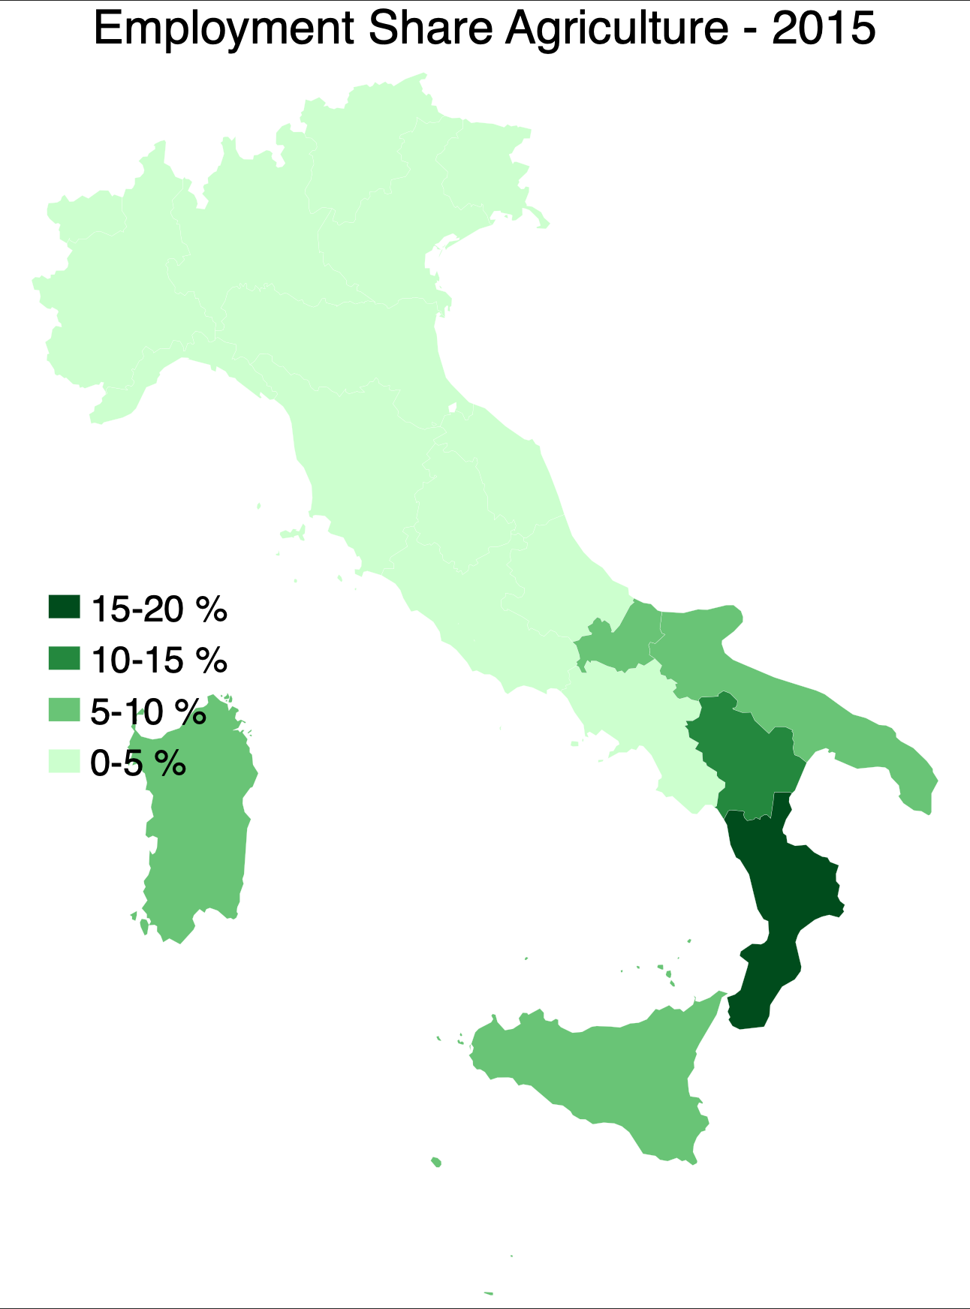
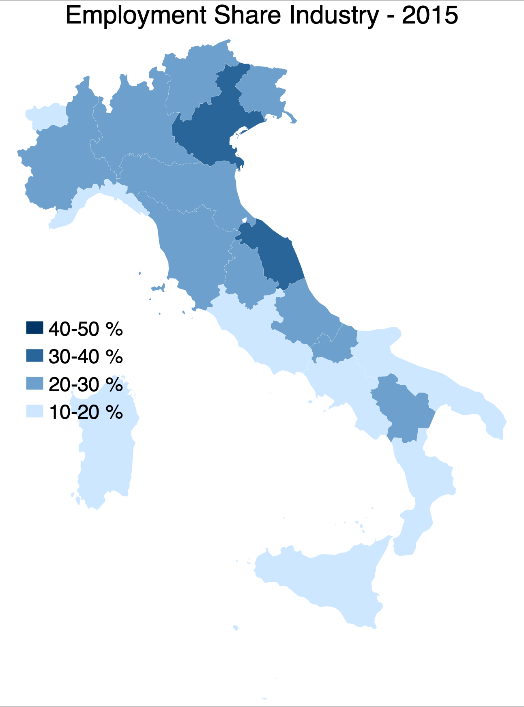
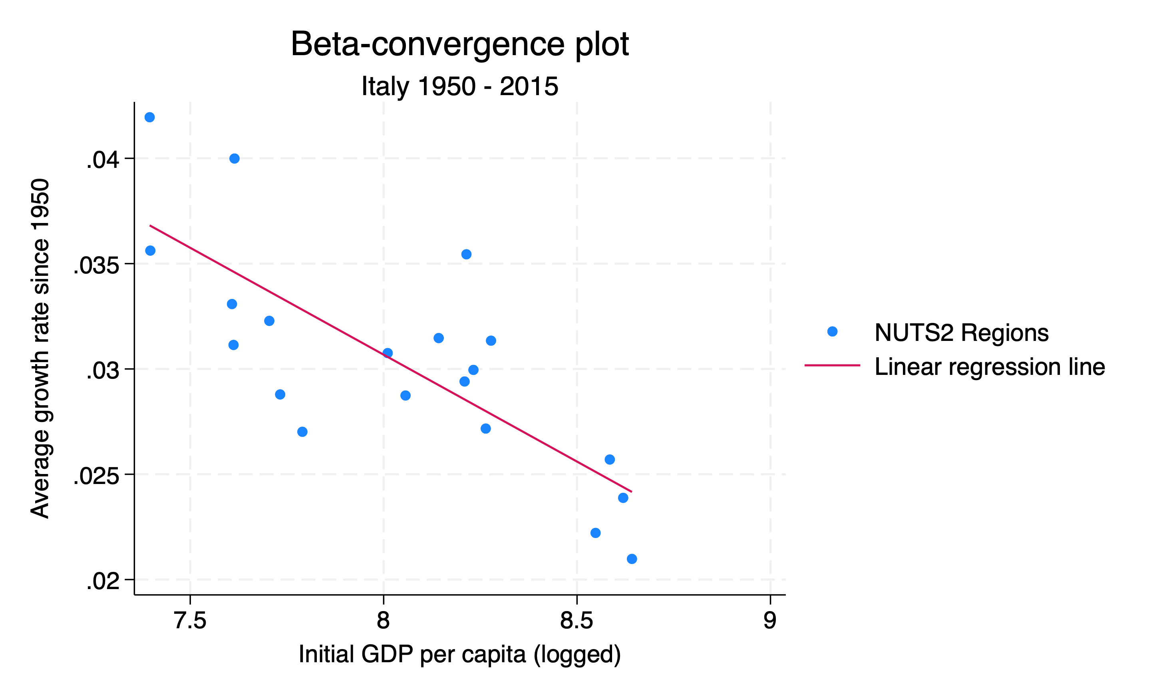
Analysis
• Present descriptive results (maps, tables) and basic summary statistics. • Report econometric findings (beta convergence regression, scatterplots, sigma convergence trends).
Notes:
Both maps and convergence analysis, be that in the form of regressions or in graphs.

Slide 10
Discussion
• Interpret empirical findings in light of the reviewed literature and theories. • Discuss policy implications and limitations. • Suggest areas for future research.
The findings indicate that although there is some evidence of beta convergence, the overall reduction in regional disparities has been weak, and gaps existed already in 1900 between the North and South. The modest beta coefficient suggests that the faster growth in poorer southern regions has not been sufficient to close the gap with the North. This result aligns with historical accounts that emphasize structural disadvantages and policy failures in the South.

Slide 11
Conclusion
• Summarize the main findings and contributions of the paper. • Reflect on the implications for understanding Italy’s regional disparities.
This paper has analyzed the evolution of the North–South divide in Italian regional development between 1900 and 2015. While the beta convergence analysis suggests that poorer regions in the South have grown at a slightly faster rate, the overall level of convergence remains limited. Structural factors, historical policy choices, and persistent institutional differences continue to contribute to the regional gap.

Slide 12
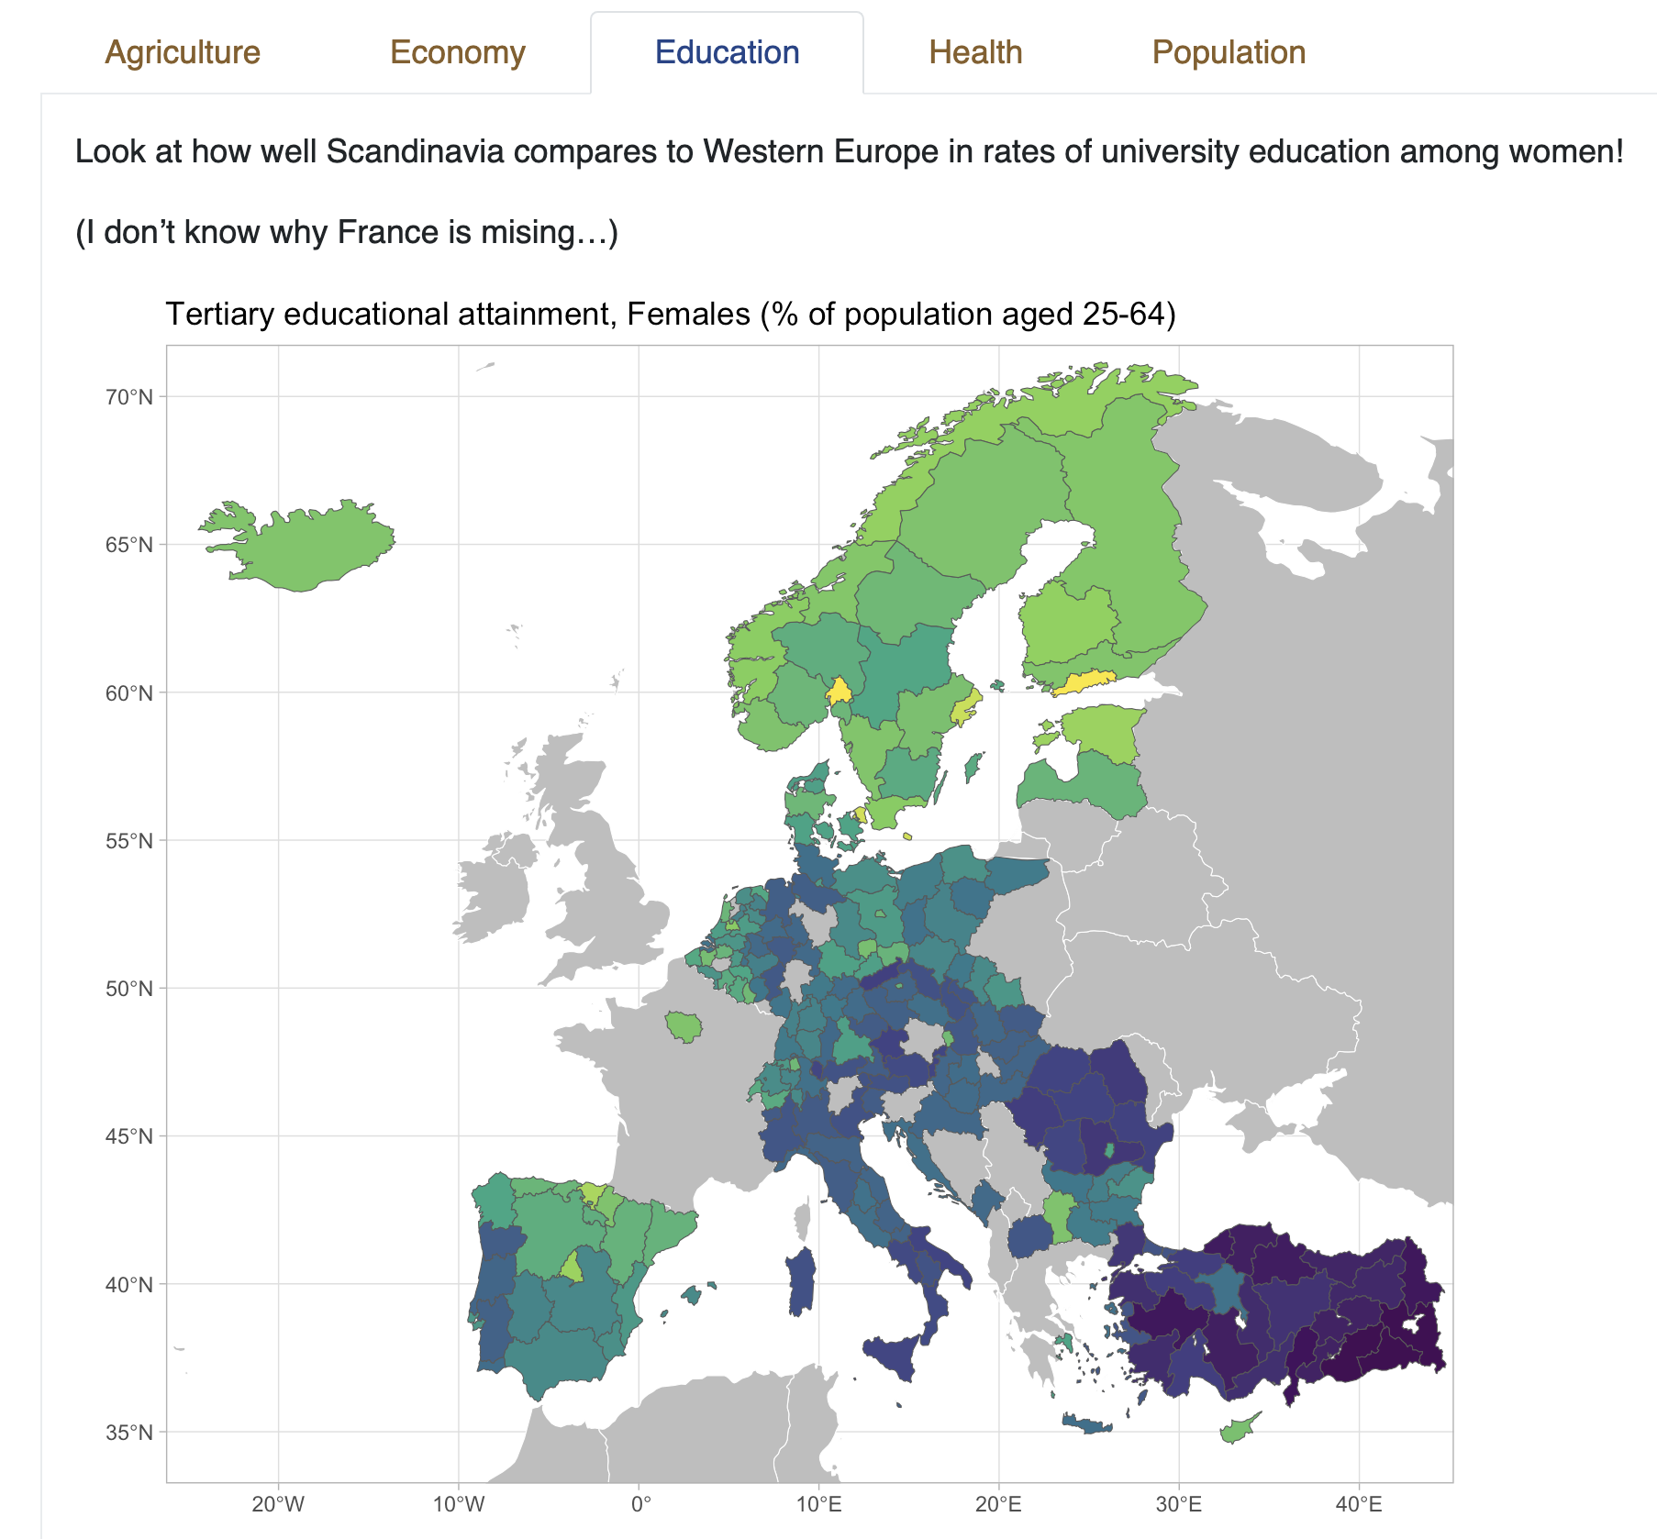
What can you do to stand out?
Use the additional data
Find it on the course website
DOSE database
Eurostat
Both have data on outcomes today, not as much historical data
I’ve formatted this into Stata format for you

Slide 13

Getting set up
Installing Stata
Notes:
Demo: https://j-jayes.github.io/EOSE09-site/resources/installing-stata.html

Slide 14

Getting set up
Downloading lab 1 files
Notes:
Demo:

Slide 15

Getting set up
Setting a working directory
Use ”regional_dataset”, clear
Notes:
Setting a working directory
You should save “lab_1” folder somewhere where you can access it.
Open a do-file that you can save in this folder.
Set your working directory.
Use “regional_dataset.dta”, clear

Slide 16
Exercises
Map of GDP per capita in Sweden and the United Kingdom in 1990
Map of share of employment in industry in 2010 across the whole dataset
Map of share of employment in services in 1950 in Scandinavia
Scatterplot of GDP per capita in 1990 dollars on the x-axis and share of employment in services on the y-axis for the year 2015. Make the colour of the points on the scatter plot show what country it is.
Make a table of the mean GDP per capita by country in 2000. Export it with the Outreg2 command.

